Slide 1
AINT351: Machine Learning Lecture 10 Sampling

Slide 2
Sample from a simple distribution
To draw samples from a uniform distribution is easy
In Matlab we can use rand which returns samples uniformly drawn from the interval of 0 and 1
We can scale the range and add on an offset to change the mean
To draw samples from a Gaussian distribution is also easy
In Matlab we can use randn which returns samples fro a zero mean Gaussian
We can scale the standard deviation and add on an offset
And change covariance as required

Slide 3
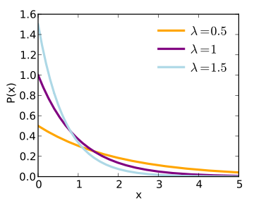

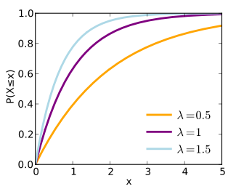

Sample from an arbitrary distribution
How can we generate say an distribution by only using samples from a uniform distribution?
Consider exponential distribution
Probability of occurrences drops of exponentially as value of x increases
Cumulative distribution is
since

Slide 4
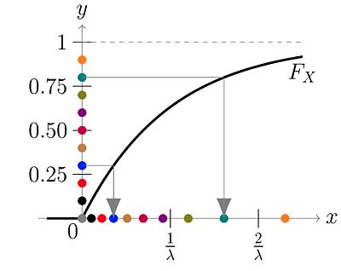

Inverse cumulative distribution function method
How can we generate samples from an arbitrary probability distribution X = f(x)?
If we have the inverse CDF of X, given by F⁻¹
Then X = F⁻¹⁽U) where U ~ Uniform[0,1]
To sample from an exponential distribution with
Sample U ~ Uniform[0,1] we do the following:
Many points end up close to 0
Only few points end up having high x-values

Slide 5
AINT351: Machine Learning Lecture 10 Monte Carlo methods

Slide 6
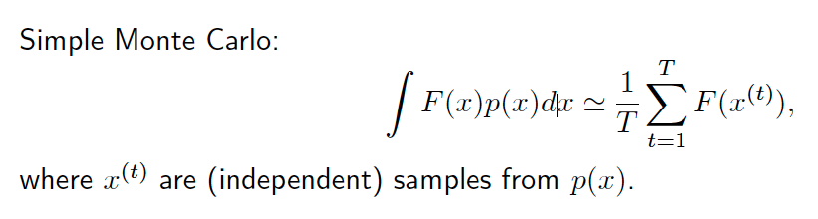
Simple Monte Carlo
Good: unbiased; variance goes as 1/T , independent of dimension!

Slide 7



Computing Expectations
We often like to use probabilistic models for data.
E.g. Naïve Bayes
Sometime we need the mean of the posterior
Sometime we need the marginal (integrated) likelihood

Slide 8
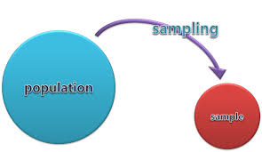
Sampling methods in machine learning
We can use sampling use to approximate expectations (mean) of a distribution statistics, probabilities
Approximating computation of intractable sums and integrals
Sampling is easy and general purpose
Can be slower than deterministic methods
Difficult to get good samples

Slide 9

Monte Carlo methods
Used to approximate expectations that are intractable analytically
Sample mean of x for n IID samples from a distribution p(x)
MC gives unbiased estimator with sd reducing by 1/sqrt(n)
If we can draw IID samples x₁, x₂, …x_{n} from distribution of p(x)
Is a Monte Carlo basic estimator of E{f(x)}

Slide 10
Sampling techniques to solve difficult problems
What is the area of a circle with radius 1?
How could we estimate this without using the formula involving π?
Area of a circle=?
Sample randomly in x and y between 1 and -1
Examine if point lies within circle

Slide 11
Computing π using Monte Carlo
For circle of radius 1
Area of circle = π *r²= π;
Area of bounding square = 4
Generate random samples uniformly distributed over a range larger that the square and the circle
Count how many fall within the circle
Count how many fall inside the square
The ratio of “samples inside circle” / “samples inside square” = π/4
Therefore
π= 4 * (“samples inside circle” / “samples inside square” )

Slide 12
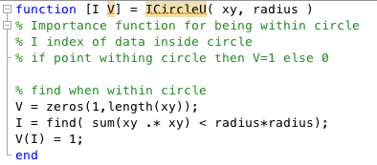
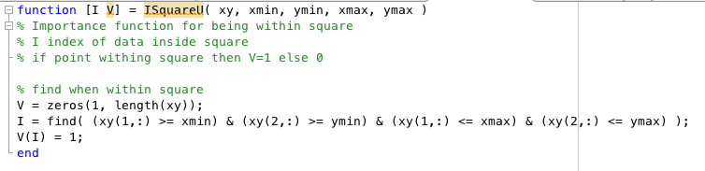
Matlab code: Importance functions

Slide 13
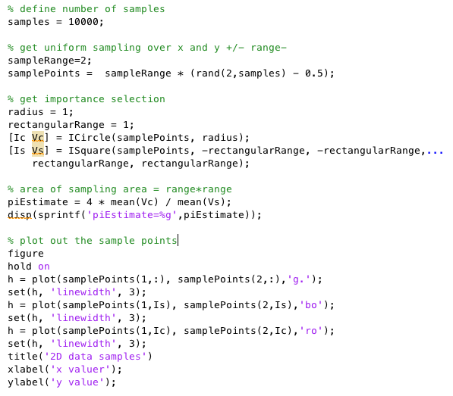
Matlab code: Estimate π

Slide 14
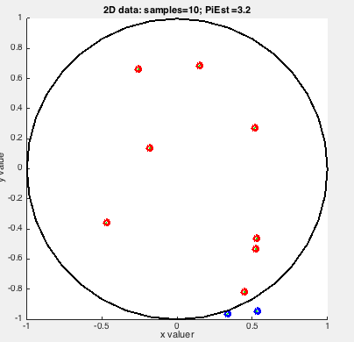
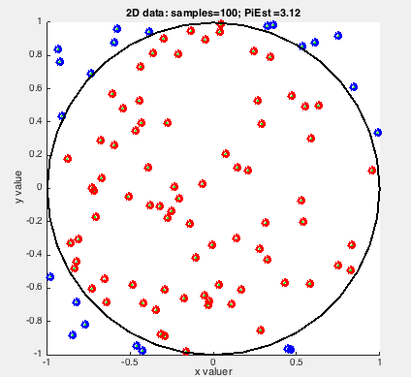
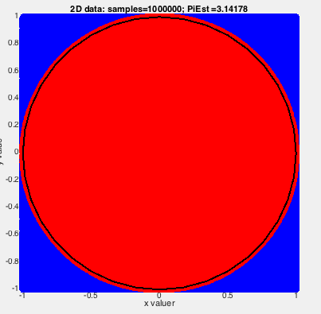
Effect of number of samples
Red points inside circle
Blue points outside circle

Slide 15
Demo

Slide 16
AINT351: Machine Learning Lecture 10 Rejection sampling

Slide 17
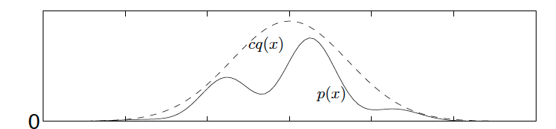
Rejection sampling
Suppose that we want to sample from our target density p (x) shown above
For the rejection sampling, we need to pick a candidate density q(x) such that:
p (x) ≤ cq(x) for all x, where c is a constant
Now sample x from q(x)
Accept x with probability p(x)/(cq(x))

Slide 18
Rejection sampling
Algorithm is to repeat the following steps until sufficient accepted draws are discovered:
Draw a candidate x_{s} from q(x)
Draw a value u from the Uniform(0, cq(x_{s})) distribution which samples uniformly between the value of 0 and cq(x_{s})
3 . Accept xs as a draw from p (x) if u <= p (x_{s})
4. Otherwise, reject xs and go back to step 1

Slide 19
Rejection sampling
Note that:
If q(x) is significantly different in shape than p (x) or if cq(x) is significantly greater than p (x), then more of our candidate draws will be rejected.
If p (x) = cq(x), then all our draws will be accepted.
A modification of rejection sampling forms the basis for the Metropolis-Hastings algorithm

Slide 20
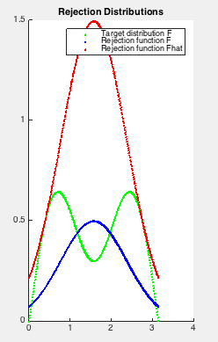
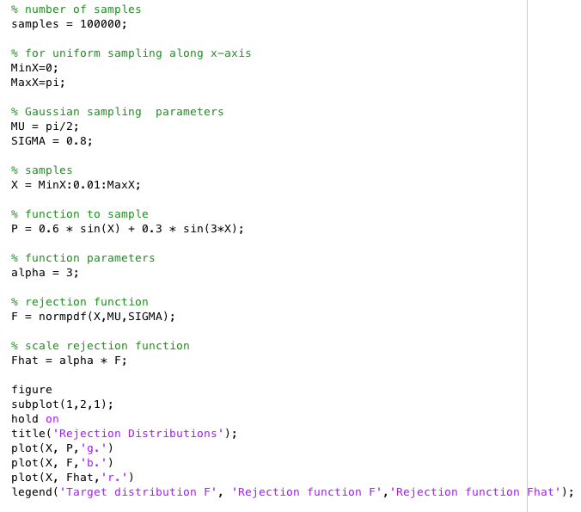
Rejection sampling example
Setup parameters
Want to sample
from double sine
Get value of rejection function
Scale the rejection function

Slide 21
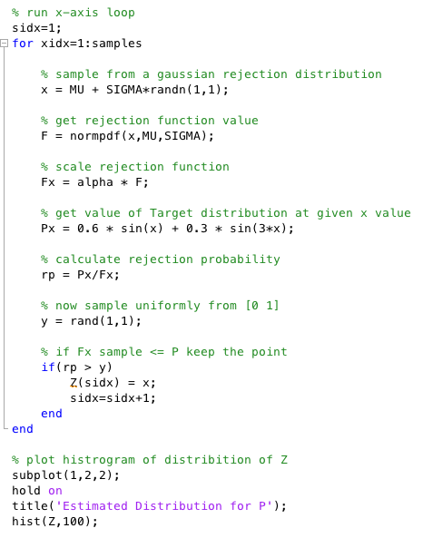
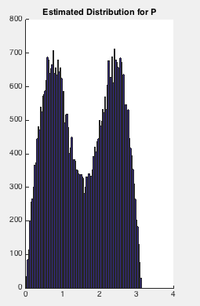
Rejection sampling example
Sample from
rejection distribution
Scaled rejection value
Probability for rejection
Choose samples randomly
based on probability for rejection

Slide 22
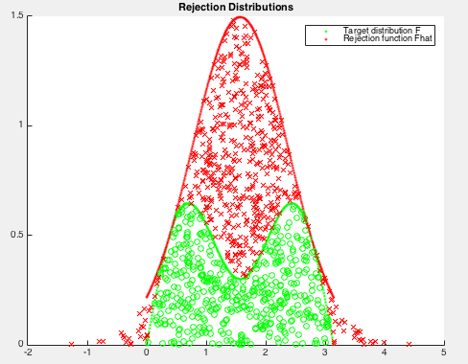
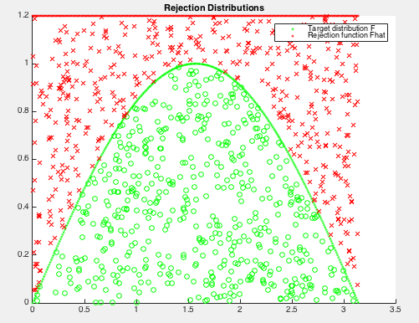
Rejection sampling example

Slide 23
Demo

Slide 24
AINT351: Machine Learning Lecture 10 Importance sampling

Slide 25
Importance sampling
One problem with rejection sampling is that you lose information when throwing out samples
Alternative is importance sampling
DO NOT Throw samples away! Weight them!
Importance sampling is a variant of MC approximation
Approximate expected value of E{f(x) } by sample mean sum(f(xi))
Sampling requires we can draw IID samples x₁, x₂, …x_{n} from distribution of p(x)
Remember for direct sampling

Slide 26
Importance sampling
But can we really draw samples from distribution p(x)?
Maybe we can only draw samples from distribution q(x)
If it is hard to get samples x from the true probability distribution p(x)
use a trick to sample from another distribution q(x)
Then re-weight these samples x by p(x)/q(x)):
We can compute integrals using importance sampling.
However we do not directly get samples from p(x).
Actually we can correct from using different distribution and can get better results!
With good choice of q then expected error can be less than sampling from p(x) directly!

Slide 27
Importance sampling
Lets suppose we want to compute some expectation integral
We choose a distribution q(x) that is easier to sample from than p(x) and is similar to p(x)
Idea is we can now sample from q(x) and weight results to compensate

Slide 28
Importance sampling
p(x)/q(x) = W(x) is the weighting factor
q(x) and p(x) must exhibit some basic properties
In practice we need to try to ensure that:
Using q(x) lets us sample where it is important
Hence important sampling!

Slide 29
AINT351: Machine Learning Lecture 10 Monte Carlo Markov Chain (MCMC)

Slide 30
What is MCMC?
Monte Carlo Markov Chain algorithms are another kind of random sampling algorithms
They can be used to yield approximations where analytical computation is not tractable
They construct a trajectory through a (possible) high-dimensional state space that holds the Markov property
Next state only depends on the previous state, and can be used to sample (approximate) from probability distributions

Slide 31
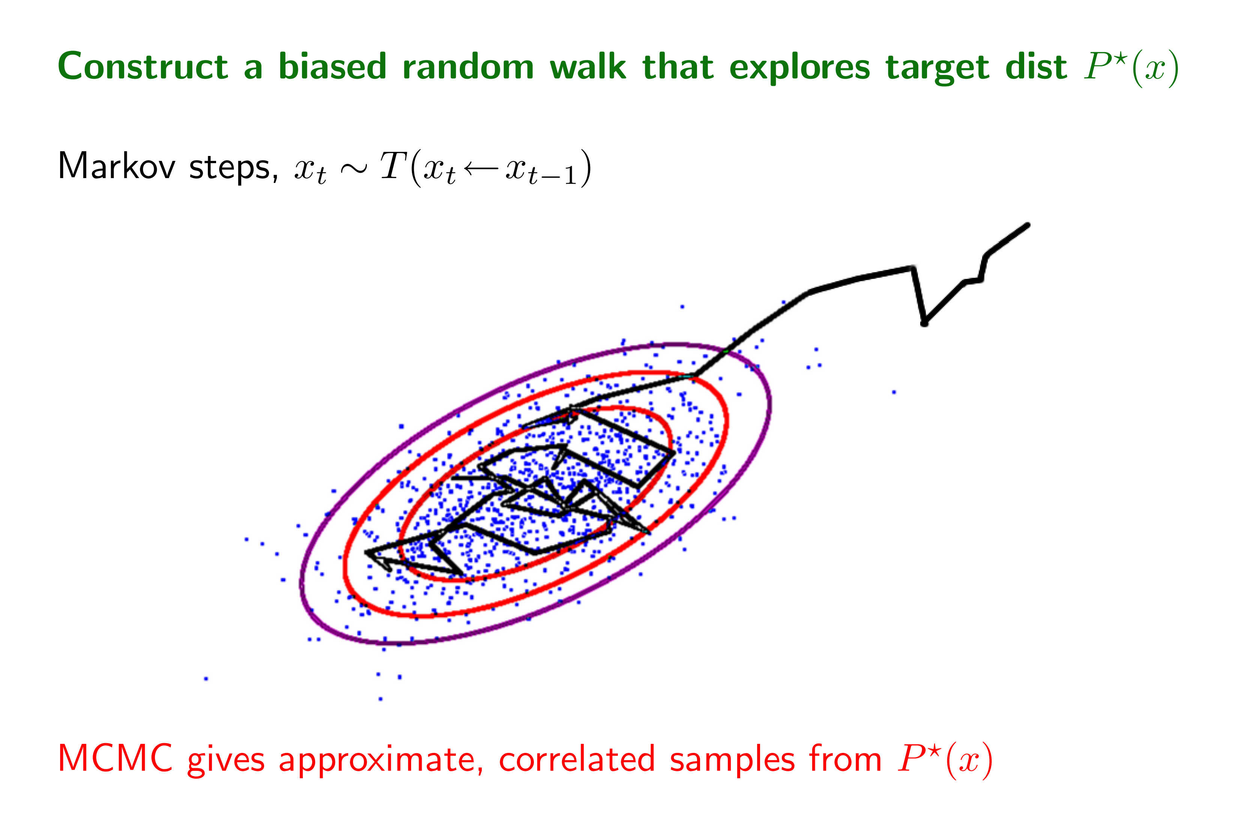
Its a random walker, that explores the state space such that the visited states are distributed according to a certain distribution The trajectory of this random walker is simulated by a Markov chain The objective of MCMC algorithms is to asymptotically generate states x according to a desired distribution P(x) and uses a stochastic process to fulfill it
Markov chain Monte Carlo

Slide 32
Sampling from distributions
Problem: It may be difficult to obtain the samples from p(x) and generate samples {x₁, x₂. . . , X_{n}}
Alternatives:
Direct simulation using the inverse CDF to transform uniform samples
Rejection sampling
Metropolis-Hasting MCMC
If we can sample from conditional distributions then we can use Gibbs sampling
Note that MCMC methods DO NOT results in independent samples!

